Slide 1
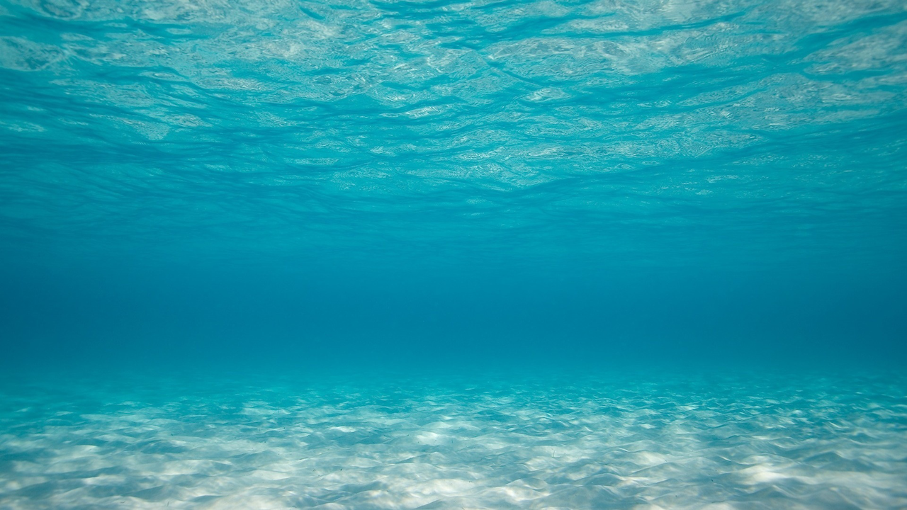
AQUA
(Latin: water)

Slide 2
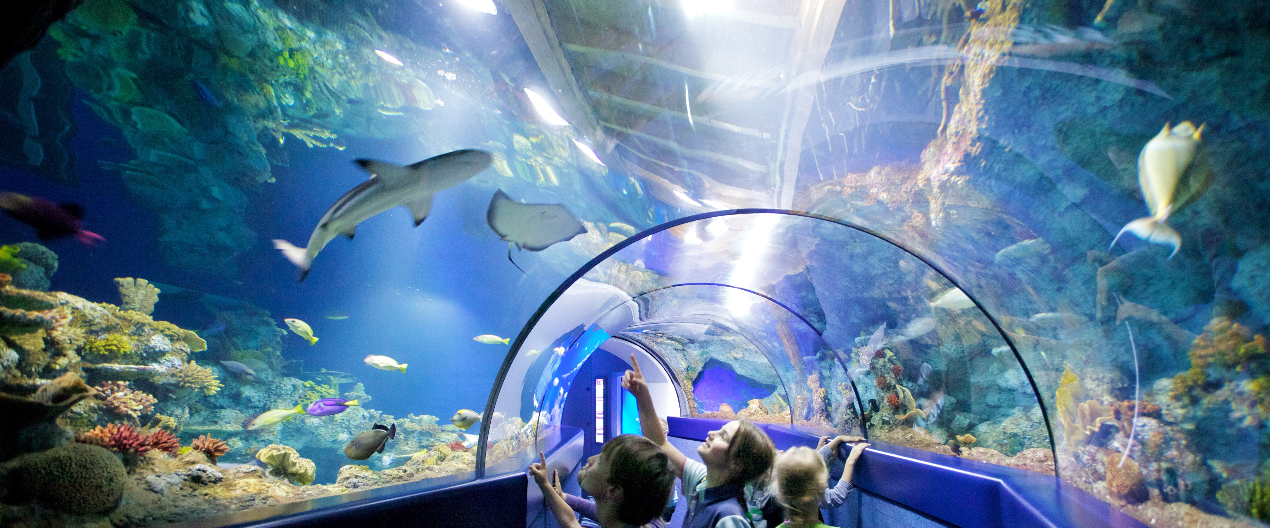
aquarium: a pond or tank of water where fish or water plants live

Slide 3
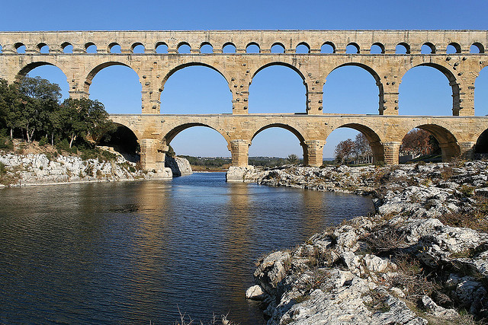
aqueducts: a structure for bringing water to where it is needed
duco, ductum: to lead

Slide 4
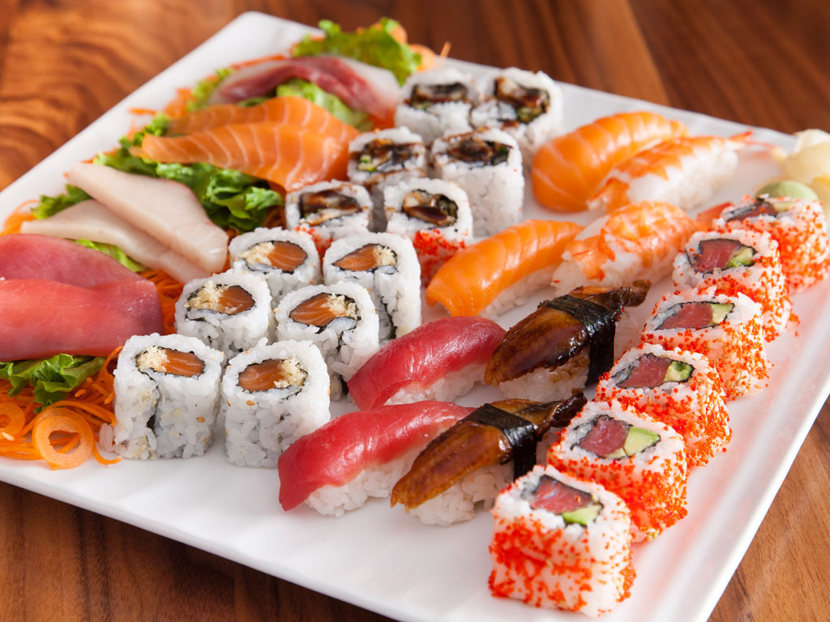
aquaculture: growing food in water (like fish, oysters, and seaweed)
cultura: to tend, cultivate

Slide 5
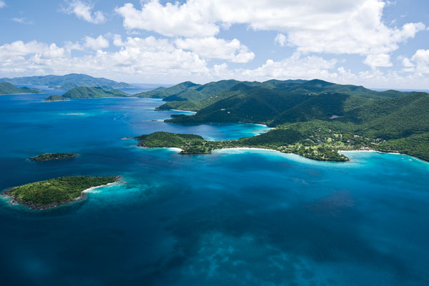
aquamarine: blue-green color of water

Slide 6
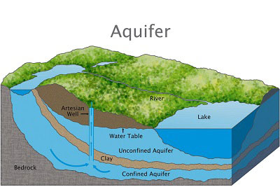
aquifer: a layer under the earth where water flows
fero, latum: to carry

Slide 7
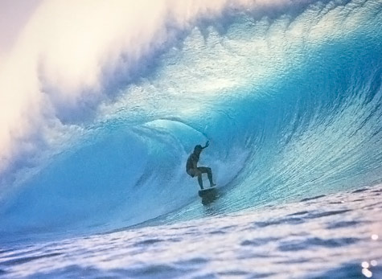
aquaplane: surf board
planus: flat surface

Slide 8
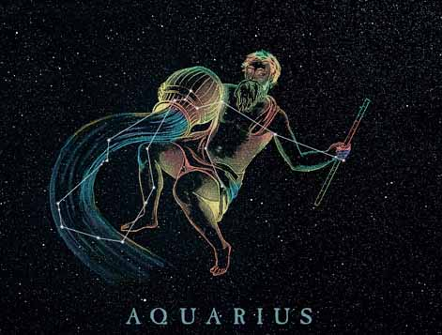
Aquarius: a constellation called “water carrier”

Slide 9
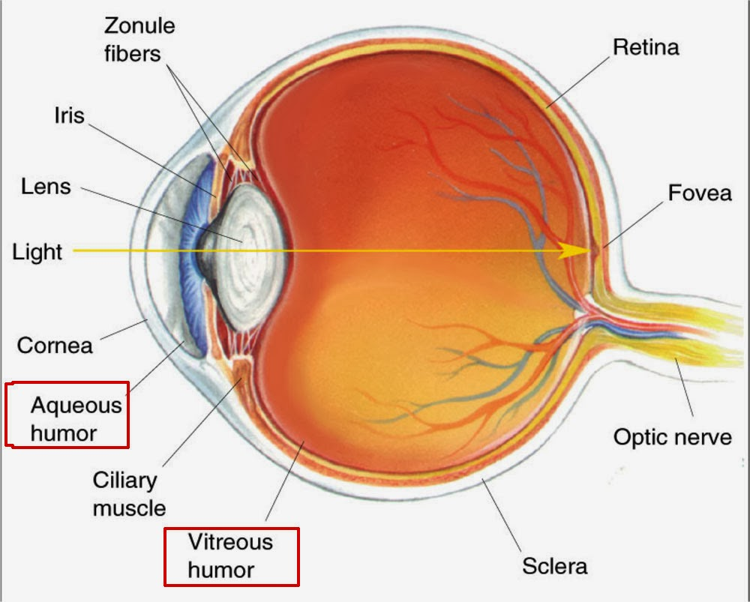
aqueous humor: fluid in the eye between the lens and cornea
humor: moisture

