Slide 1
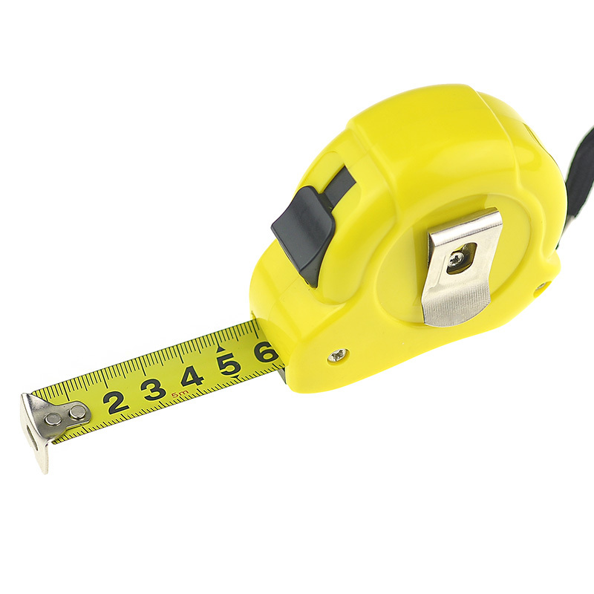
METRON
(Greek: measure)

Slide 2
meter: unit of measurement
39.47 inches long

Slide 3
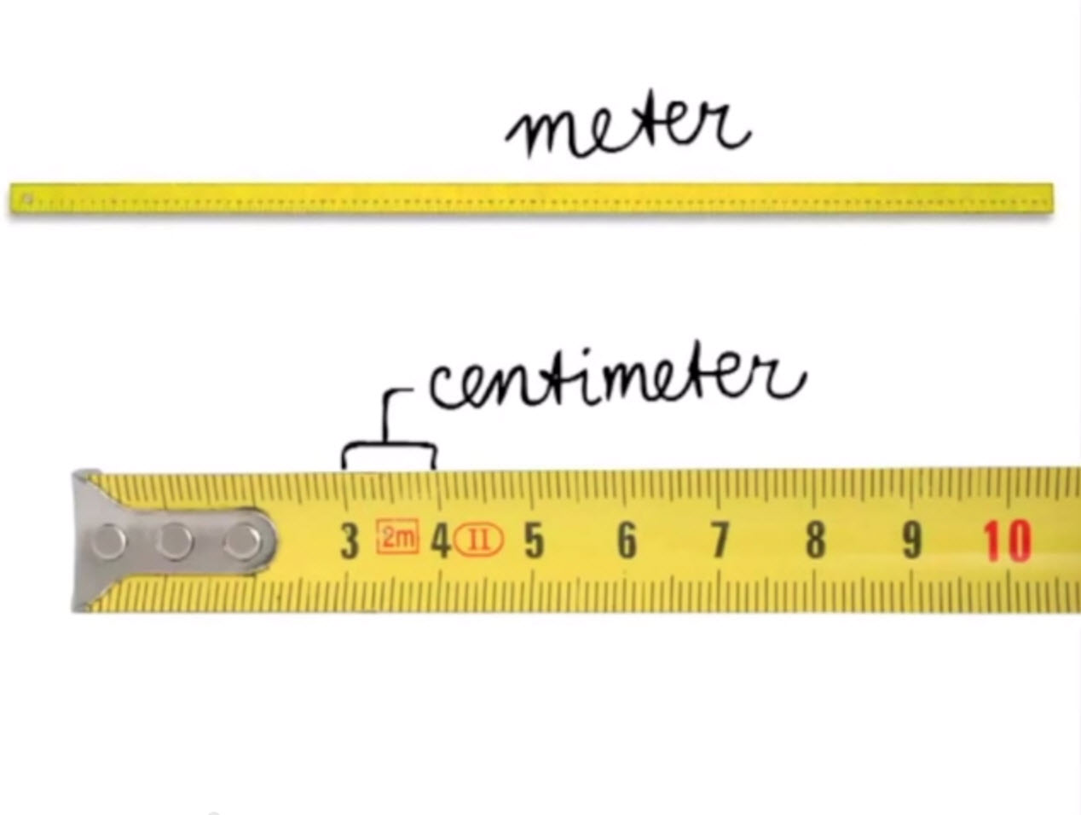
centimeter: one hundredth of a meter
centum: hundred

Slide 4
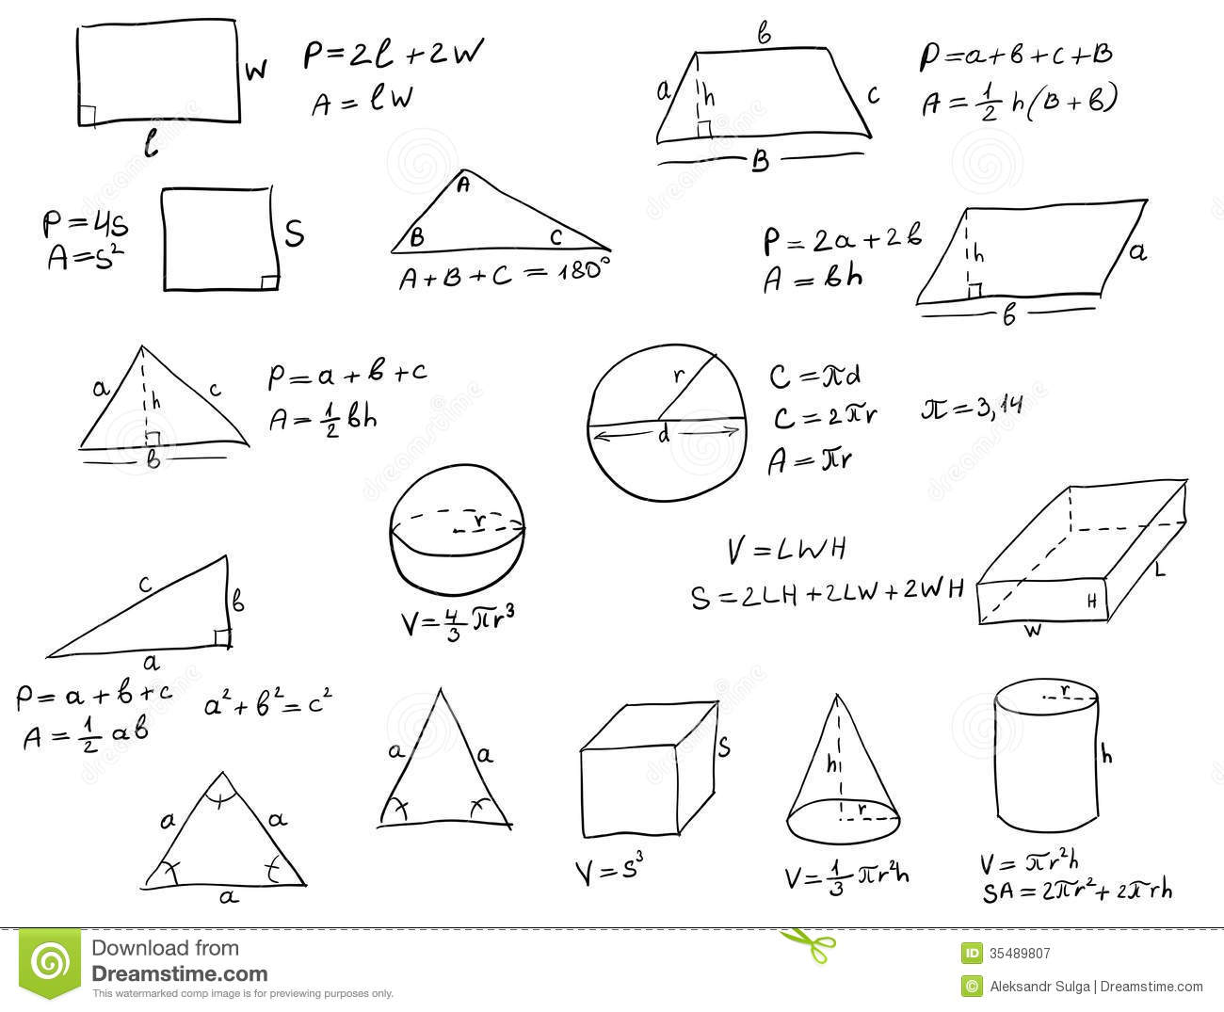
geometry: measuring the earth
geo: earth

Slide 5
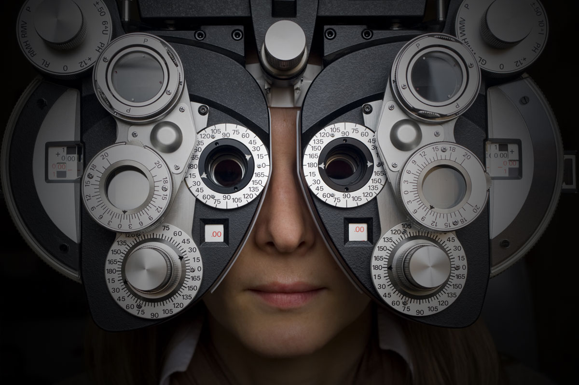
optometry: measuring eyesight
opsis: sight

Slide 6
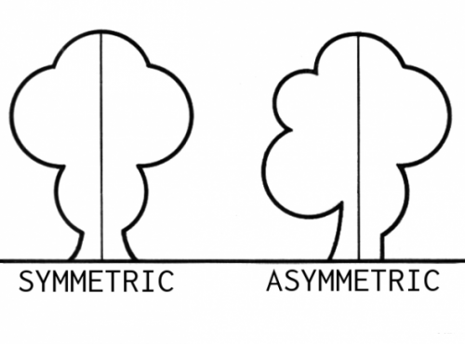
symmetry: measuring the same
sym: same, together

Slide 7
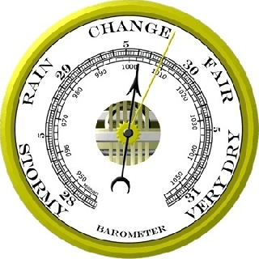
barometer: measuring air pressure
baros: weight, pressure

Slide 8
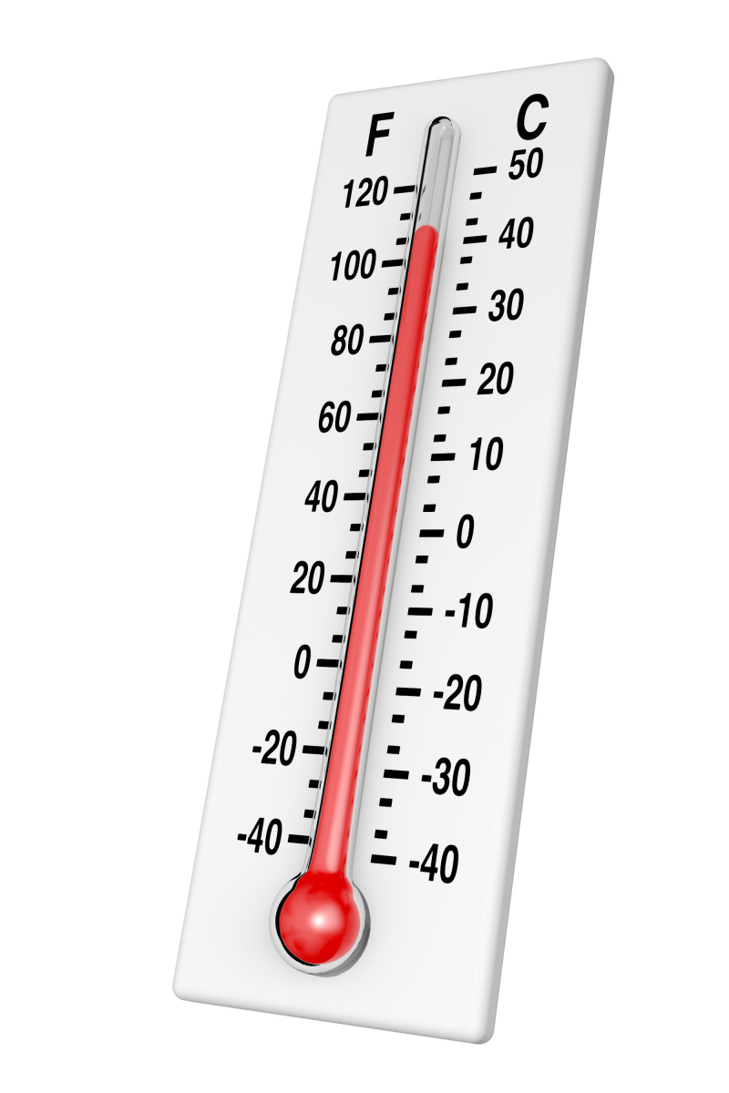
thermometer: measuring heat
thermos: heat

Slide 9
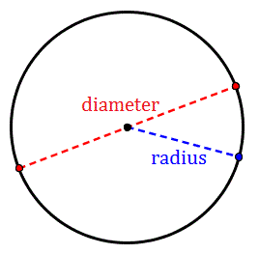
diameter: measuring across
dia: through, across

Slide 10
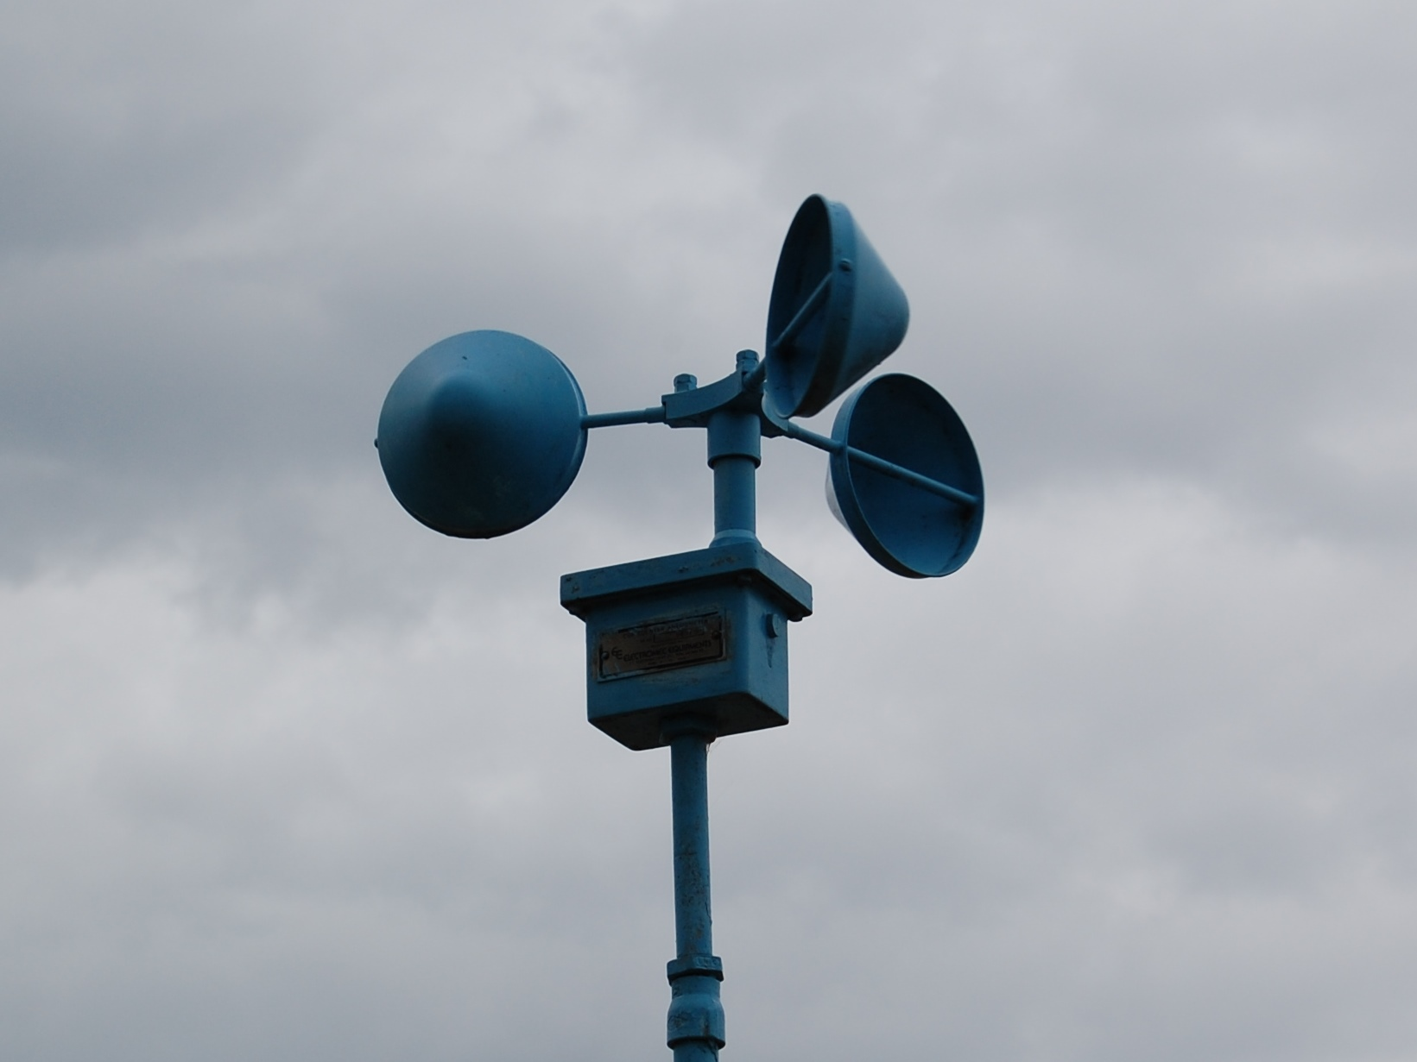
anemometer: measuring wind speed
anemos: wind

